Slide 1

Box Office Blueprint: Data-Driven Insights for Microsoft Movie Studio Launch.

Slide 2

AGENDA
PROBLEM STATEMENT
DATA UNDERSTANDING
RESULT & FINDING
RECOMENDATION

Slide 3
Problem Statement
This project aims to guide the establishment of a new movie studio lacks experience in movie making by providing actionable insights into the key factors that drive box office success.
Objectives:
Identify successful movie characteristics.
Pinpoint profitable genres.
Determine optimal budget ranges.
Strategize release timings to maximize box office revenue.

Slide 4
Data understanding
The dataset used for this project combines information from multiple sources, each offering unique and complementary insights into movie attributes and box office performance.
Below is a breakdown of the data sources used and the specific datasets obtained from each.
Box Office Mojo- Provides comprehensive box office earnings of other production studios including their (domestic and international) revenue data.
IMDB - Comprehensive movie database featuring production details, cast and crew (including directors, writers, actors, and producers), user ratings and votes, as well as metadata such as title, release year, runtime, genre, and biographical information.
The Movie Database - Collaborative movie database providing community sourced metadata such as popularity, vote count, and original language
The Numbers- Provides financial data on movies, including production budgets, worldwide gross, and estimated profits
Datasets used for Analysis:
`tn.movie_budgets.csv.gz` → Used for financial and studio performance analysis (budget, gross, profit, ROI).
`bom.movie_gross.csv.gz` → Supplementary financial data, focusing on domestic and international gross.
`imdb.title.basics.csv.gz` → Used to extract genre, runtime, and title information.
`imdb.title.akas.csv.gz` & `imdb.title.principals.csv.gz` → Contains Movie Metadata like genre, runtimes, directors, actors, and producers for talent influence.

Slide 5
ANALYSIS OVERVIEW
To address the business problem of helping a new movie studio with no prior movie making experience, we structured our analysis around these key pillars:
Financial Performance Metrics
We analysed financial data to understand what makes a movie financially successful. Using production budget, gross earnings, and calculated metrics like profit and Return on investment (ROI), we identified patterns in profitability across diffrent budget ranges and time periods. This helped us determine cost effective production strategies and the financial risks involved in different investment levels.
We also applied regression model to quantify the impact of Production budget on financial outcomes like Return on investment(ROI).
b) Market Landscape
To understand the industry dynamics, we conducted a competitive analysis of global box office trends to identify the top studios and examine their revenue patterns over time.
c) Influence of Talent
We also looked at the impact of directors, producers, and lead actors on movie performance. By linking cast and crew data with box office returns, we checked whether specific individuals consistently drive higher profitability or audience engagement. This aims to support informed hiring decisions for the studio.

Slide 6
ANALYSIS OVERVIEW
d) Audience preference
We explored ratings, genre trends, and runtime distributions to better understand what types of content resonate most with audiences. By segmenting movies by genre, rating, and popularity metrics, we gained insight into audience preference. This enables the studio to tailor content to audience tastes while balancing creative goals and market viability.
e) Basic Movie Meta data for Strategic Decision Making
Finally, we considered general movie attributes such as release year, language, and runtime to identify seasonal trends, optimal movie lengths, and how content success has evolved over time. These are critical for shaping release strategies and production planning.

Slide 7
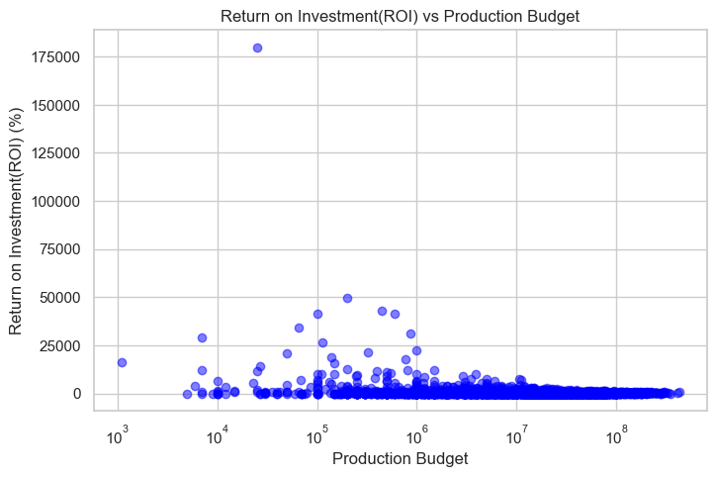
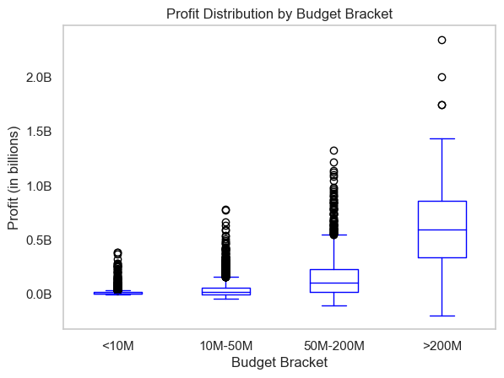
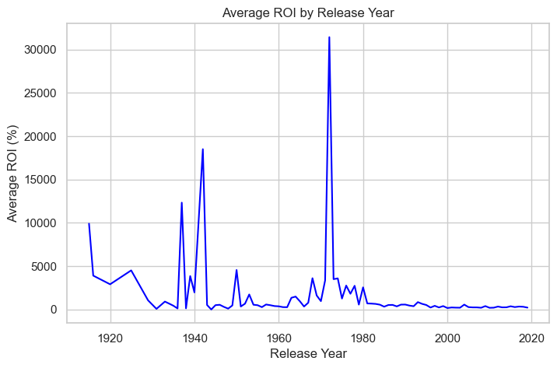
Results & Findings
Financial Performance Metrics –
Low to mid budget movies (under $50M) tend to have higher ROI, making them more profitable relative to cost and less financially risky.
High budget movies ($200M+) show wide fluctuations in returns.
$50M–$200M budget range appears to balance strong profit potential with manageable risk.
Domestic success is a strong predictor of international earnings, though there are exceptions.
Historical ROI was higher in the 1930s–1970s compared to recent decades.
Regression model showed that production budget alone has very little predictive power for ROI (R² = 0.0069).
Global box office revenue does not increase consistently year over year, indicating volatility in the industry.

Slide 8
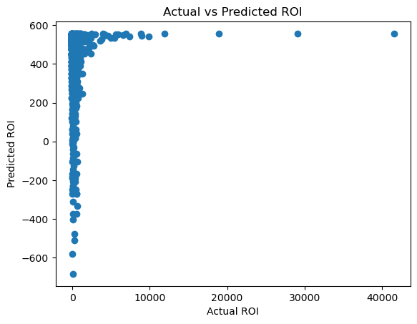
Results & Findings
b) Regression Modelling -
We explore which production budget yields the highest return on investment (ROI).
We applied a simple linear regression model to examine the relationship and evaluated its performance using R² and Mean Squared Error (MSE).
The model shows that production budget alone has almost no predictive power for a movie’s ROI (R² = 0.0069), meaning we can’t reliably estimate profitability just from how much was spent on production.
To make better predictions, we would likely need a broader range of data that captures the full financial picture of a movie’s lifecycle. Production budgets typically exclude other critical financial factors such as marketing expenses, cinema or streaming platform cuts, and backend deals. Simply spending more on production doesn’t guarantee higher returns.

Slide 9
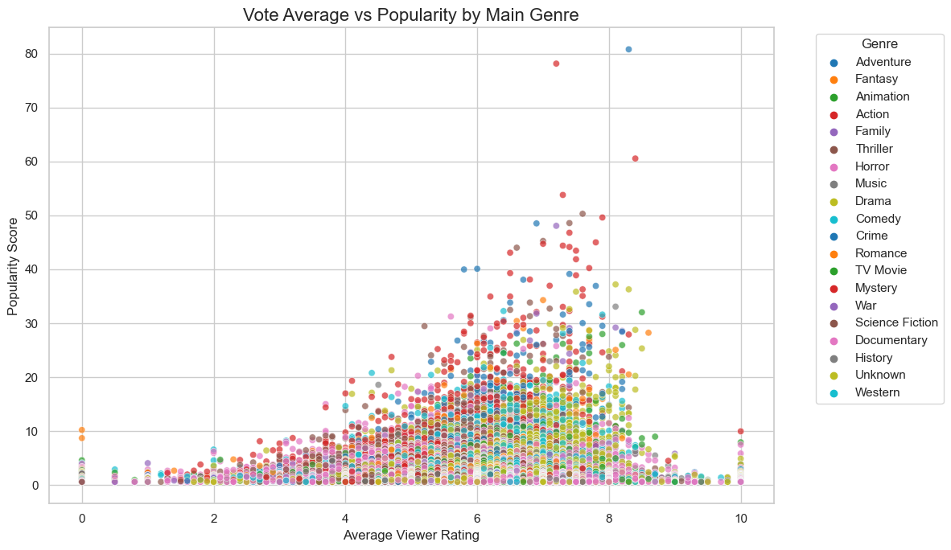
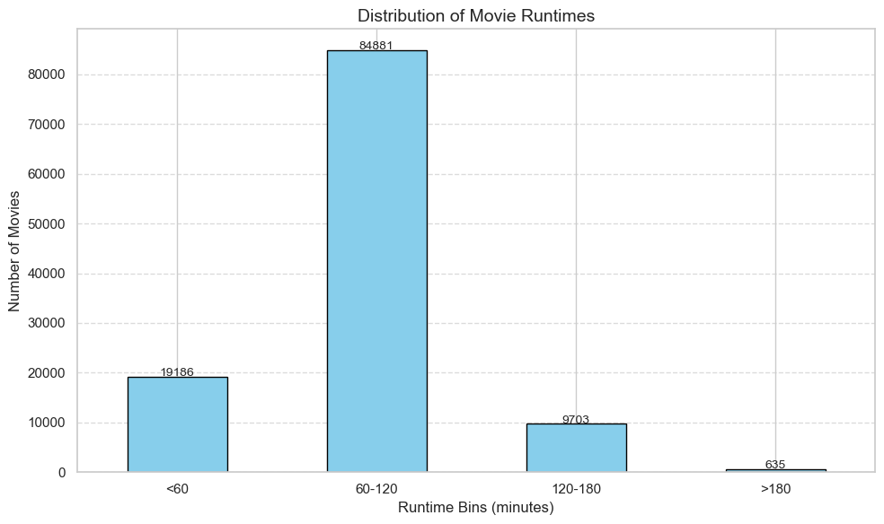
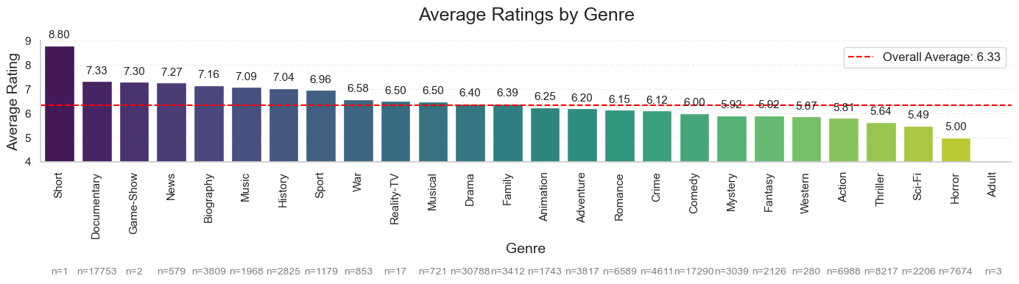
Results & Findings
c) Audience Preference -
Fantasy and Animation genres receive high viewer satisfaction.
Movies with average viewer ratings of 6+ generally perform better in the market.
Action, Sci-Fi, and Adventure are highly popular but have mixed reviews.
Drama, Animation, and Family genres receive more consistent reception.
Genre blending (e.g., Action-Thriller, Adventure-Fantasy) can enhance appeal.
Audiences strongly prefer clear genre positioning, suggesting difficulty marketing multi-genre films.
Movies in the 60–120 min range are most popular.

Slide 10
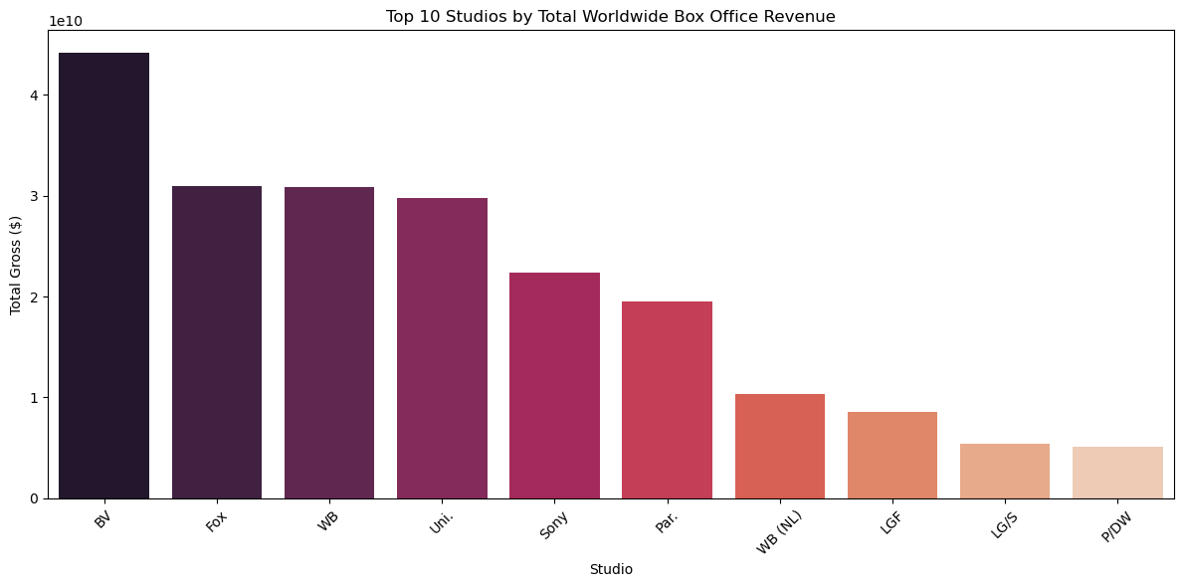
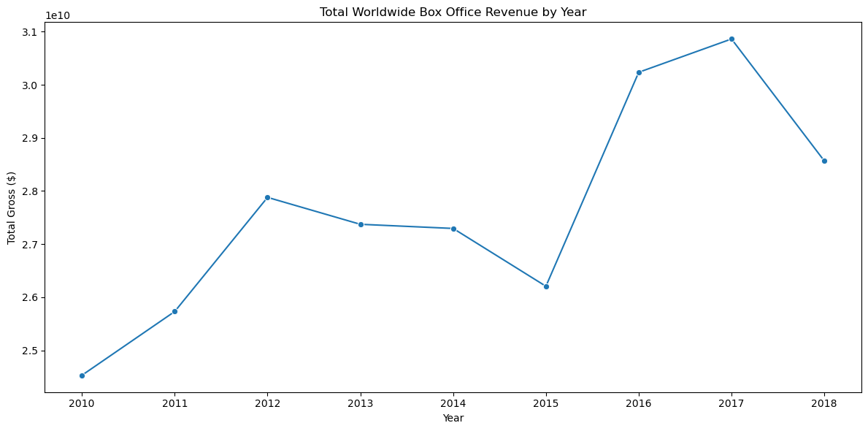
Results & Findings
c) Market Landscape -
To understand the industry dynamics, we conducted a competitive analysis of global box office trends to identify the top studios and examine their revenue patterns over time.
Leading studios demonstrate fluctuating revenue patterns, highlighting the importance of continuous market research and adaptability..

Slide 11
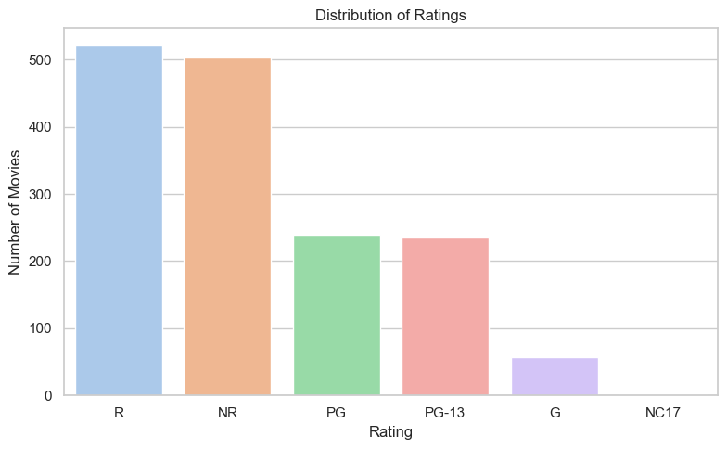
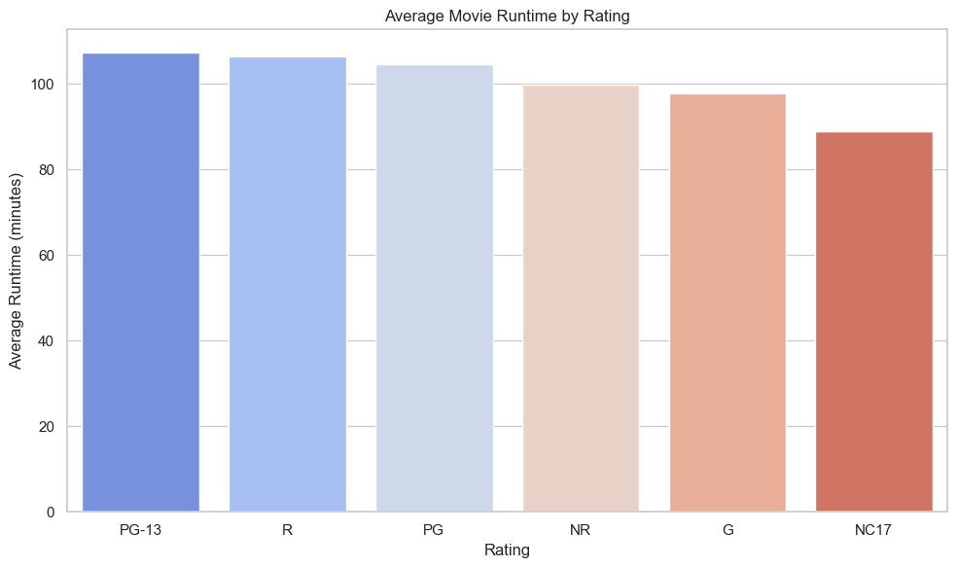
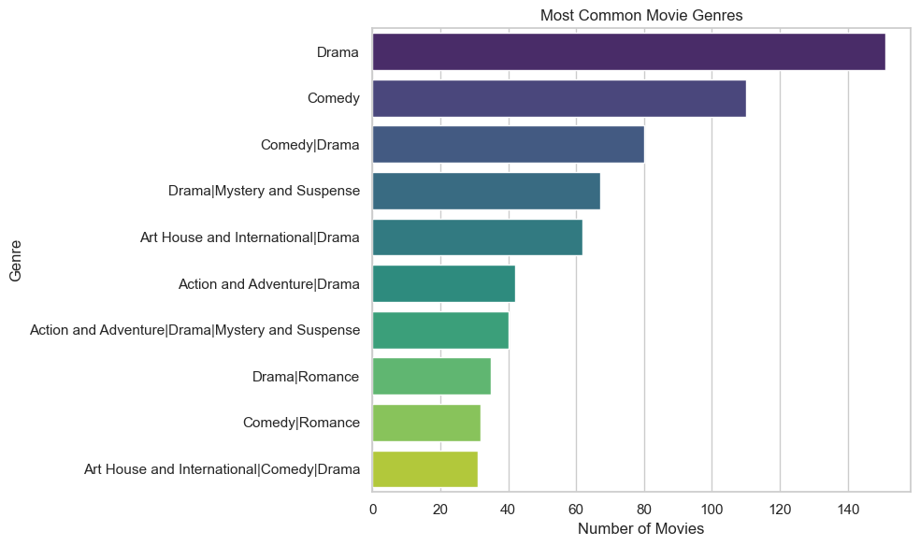
Results & Findings
d) Basic Movie Metadata
Drama is the most common genre and blends well with others.
R and NR are dominant ratings; PG and PG-13 are more competitive.
Longer runtimes tend to correlate with PG-13 and R ratings, which are the most common.
Average movie runtime by rating clusters around 100–110 minutes.

Slide 12
RECOMENDATION
Production budget alone does not reliably predict financial success. The studio should diversify investment and allocate resources strategically, factoring in marketing, distribution, and talent costs to maximize ROI.
Prioritize collaboration with directors, producers, and lead actors who have consistently demonstrated positive impact on movie performance to improve profitability and audience engagement.
Tailoring movie content to align with our audience preferences, while balancing creativity, will enhance market reception and box office returns.
Understanding seasonal trends and optimal runtimes can improve audience turnout and overall performance. Strategic scheduling of releases is recommended.
Continuous market research is essential to stay ahead in a rapidly evolving industry by actively tracking top studios’ revenue patterns helps identify emerging trends and potential market gaps.
Conclusions:
Our analysis provides a foundational understanding to guide the launch of a new movie studio. However, there are some limitations and challenges to consider:
The dataset does not capture the full financial cycle such as marketing budgets and revenue splits with theatres. These missing variables are critical for developing a comprehensive financial picture.
The rise of streaming platforms like Netflix, Amazon Prime, and Disney presents both challenges and opportunities, which are not fully reflected in the data. The new studio should explore hybrid release strategies to adapt to this evolving landscape.
We encourage the stakeholders to expand their definition of success beyond traditional financial metrics like ROI and to include:
Audience ratings and critical reception
Streaming platform viewership,
Award nominations and wins, which contribute to prestige and long-term brand value.
While this analysis provides actionable insights into financial performance, talent influence, movie characteristics and strategic release planning of a movie, the studio’s ultimate success will rely on its ability to continuously adapt to industry shifts.

Slide 13

THANK YOU
Hafsa M.Aden
Ryan Karimi
Rose Muthini
Elizabeth Ogutu

